Slide 1


Keysight Lunch and Learn : Automating High-Speed Digital Systems with Python: When, Why, and How?
Automating High-Speed Digital Systems with Python: When, Why, and How?
Automating High-Speed Digital Systems with Python: When, Why, and How?
Tim Fairfield Senior Solutions Engineer
January 2026

Slide 2
Premise
Instrumentation Automation is a vast world, This will help you get started!
This Presentation focused on a few digital products (Scope and Bert) but applies to all product lines (RF, Power supply) and even other instruments in the industry
Demonstrates how to get started, how to initially test communication, Keysight toolsets and procedures to get code running quickly and reliably
Focuses on SCPI calls using Python programming using Pyvisa, There are many other ways to program (Matlab, C/C++ C#, IVI, .NET) however this is the predominant method of programming we see used daily in major companies today.
Uses these tools to show you how to “fish for yourself”
Use AI to speed up coding and assist you along the way
Issues that may crop up and solutions to avoid these issues
Get started now , whatever your coding level is.

Slide 3
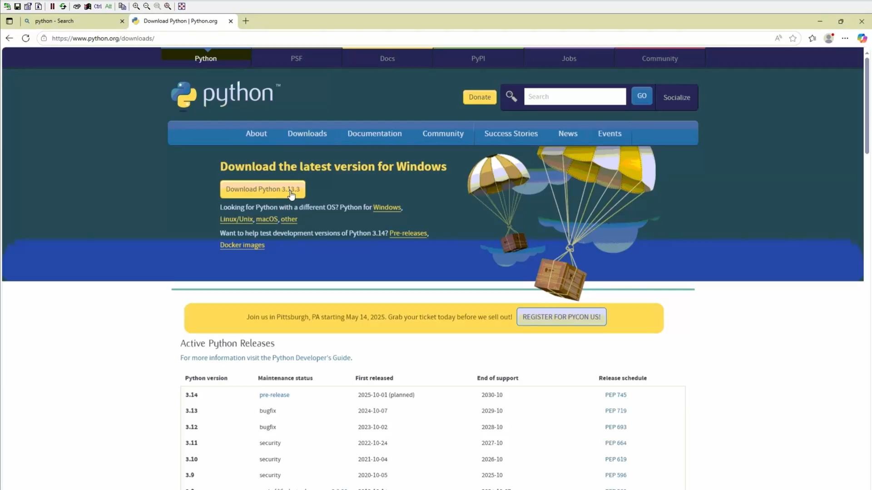
Prerequsite Install Python 3.12
Python.org/downloads Python v3.12 or higher recommended
Install Python 3.12,
add to environment variables PATH (this makes package installing and running code much easier)
Make sure to download the 64 bit version
IDLE is the default programming editor but I prefer either Visual Studio code Or Pycharm as they are more powerful debug tools
Install the package pyvisa from command line “pip install pyvisa”
Verify PYVISA is installed . From interactive mode “import pyvisa”
Run a basic Hello World make sure things are running

Slide 4
Why Automate in the first Place??
Eliminate Repetitive Tasks Automate recurring procedures across one or multiple instruments to save time and reduce human error.
Increase Efficiency Run tests faster and in parallel across multiple systems—one person can manage several setups simultaneously.
Scalability Easily scale operations by renting or adding more systems without increasing manual workload.
Flexible Deployment Create internal tools for personal use or deploy automation solutions to field teams or manufacturing lines.
Consistency & Accuracy Ensure repeatable and reliable results every time, minimizing variability in testing or data collection.
You may not have physical access to the instrument (up a tower, in a clean room, in a hazardous environment, in a remote office i.e. Covid restrictions motivated many to do remote testing)

Slide 5
Why SCPI?
Standard Commands for Programmable Instruments
Industry Standard for Decades SCPI has been a long-standing standard for instrument communication—used reliably for over 20 years.
Universal Command Set Most instruments support a common set of commands (e.g., identification, querying options), making automation more consistent and predictable.
Simplifies Integration Familiarity with SCPI commands allows easier scripting and control across different instruments and vendors.

Slide 6
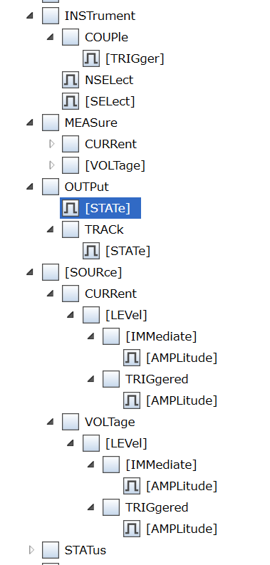
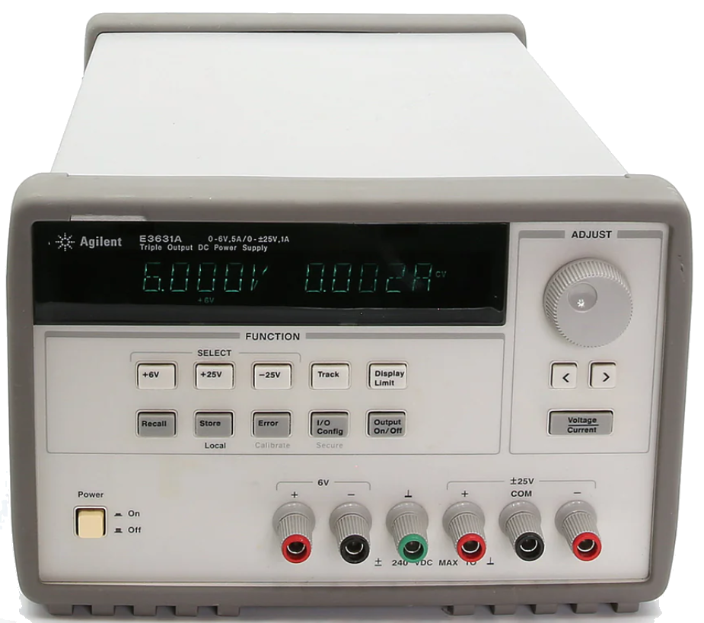
SCPI Fundamentals
Root command
Sub Command
If you can press a button or turn a dial on the instrument or select it in a menu, you can likely automate it via SCPI.
Parameter
Syntax:
Colon (:): Separates command levels. :OUTPut:STATe 0
Question Mark (?): Indicates a query. :OUTPut:STATe?
:OUTPut:STATe 0
Query (returns a value)
:OUTPut:STATe?
scope.write("*RST;:AUT;:SING;*OPC?")
Compound statements Separated by semicolon ;
Reset the instrument (*RST)
Autoscale (:AUT)
Trigger a single acquisition (:SING)
Wait for operation complete (*OPC?)

Slide 7
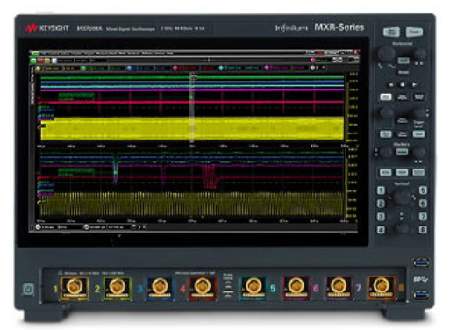
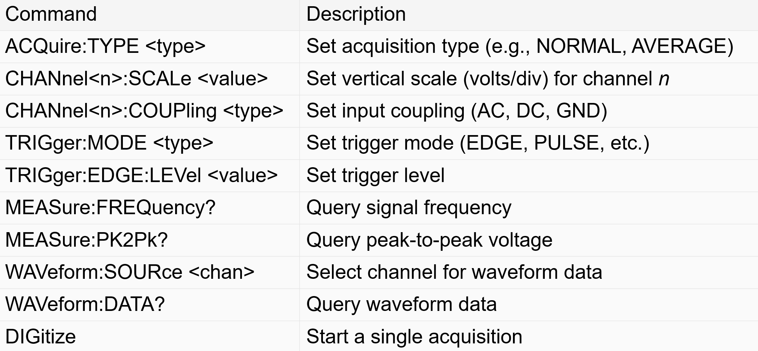
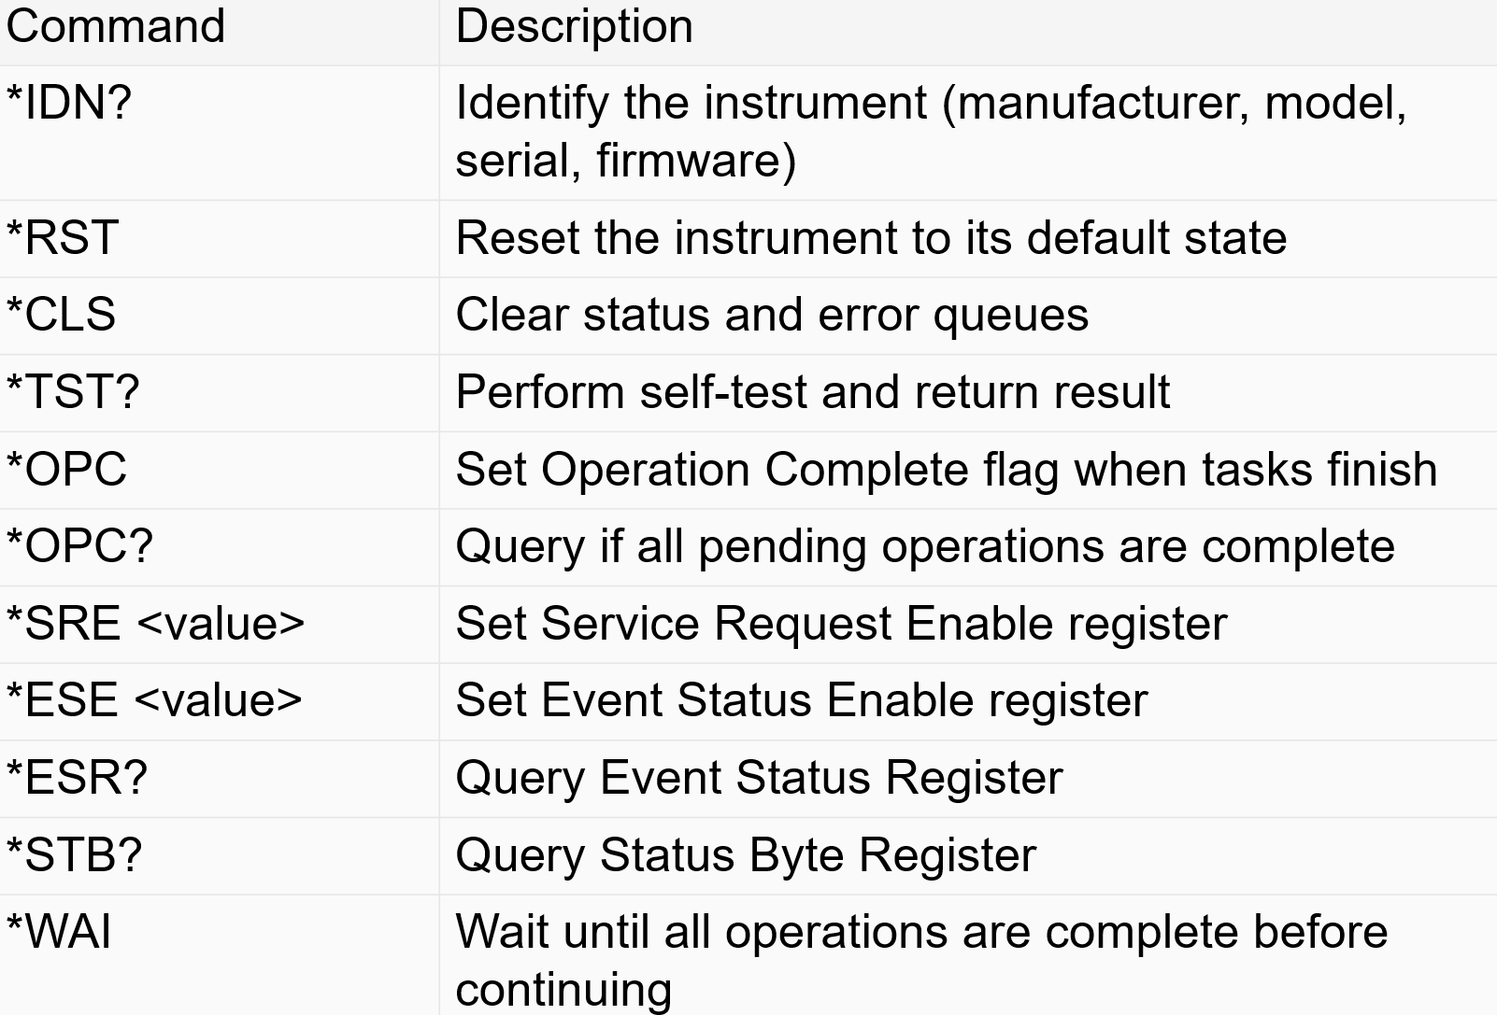
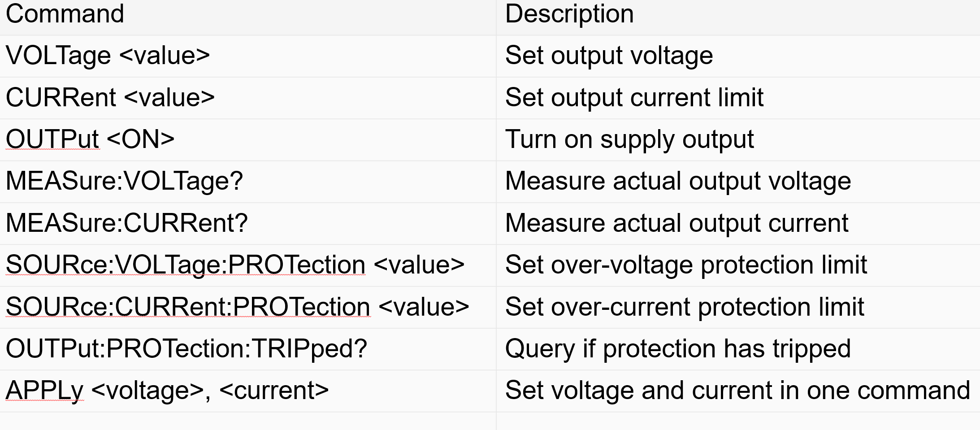
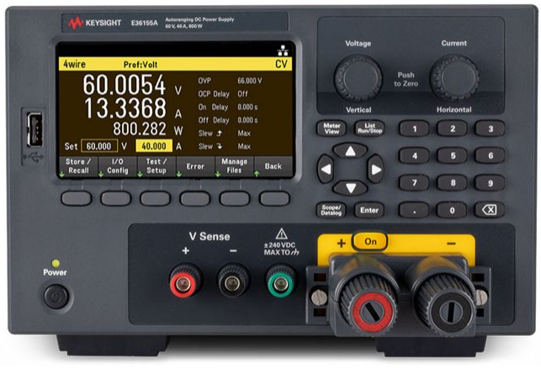
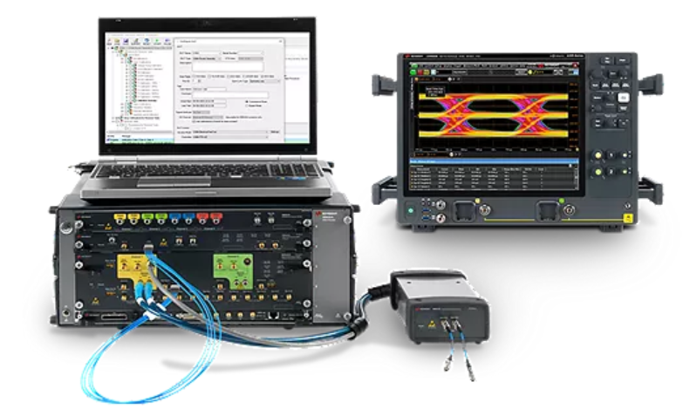
Common SCPI Commands
Instrument Specific (Scope)
General (applies to any Instrument)
Vendor and Product line Specific Commands

Slide 8
SCPI program flow & waiting mechanisms (used for reliable instrument sync/control):
Very important as some instrument operations take time and you don’t want to proceed if not ready
Default Timeout: Sets max time to wait for instrument response (prevents hangs). [Blocking]
*OPC?: Query if all prior operations are complete; blocks until done. [Blocking]
*OPC: Sets internal flag when operations finish; does not block. [Non-blocking]
*WAI: Pauses program until all previous commands are finished. [Blocking]
Instrument-specific methods: Some instruments provide unique sync/status queries (e.g., :STATus:OPERation:CONDition?, :STATus:INSTrument:RUN?)

Slide 9
SCPI Error Handling
Examples of errors and what they mean
-113: Undefined header:
Indicates that the command sent to the instrument does not contain a recognizable command name 1
.
-410: Query INTERRUPTED:
Occurs when a valid query is sent to the instrument, but another command or query is sent before the response is fully received 1
.
-420: Query UNTERMINATED:
Happens when the instrument is addressed to talk but has no response to send, often due to an invalid or missing query 1
.
-100: Command error:
Indicates a syntax error or an unrecognized command 2
.
-200: Execution error:
Occurs when the instrument cannot execute the command due to its current state or configuration
To handle and clear query and command errors in SCPI, you can use the following commands:
Clear Status:
*CLS: Clears the status byte, error queue, and all event registers 1.
Query Errors:
SYSTem:ERRor?: Queries the error queue to retrieve the next error message 2.
Standard Event Status Register:
*ESR?: Queries the Standard Event Status Register to check for errors 1.
Enable Error Reporting:
*ESE <value>: Configures the Standard Event Status Enable Register to monitor specific errors 1.
Power-On Status Clear:
*PSC ON|OFF: Controls automatic clearing of event registers upon power-on 1.
These commands help manage and resolve errors effectively in SCPI-based communication

Slide 10
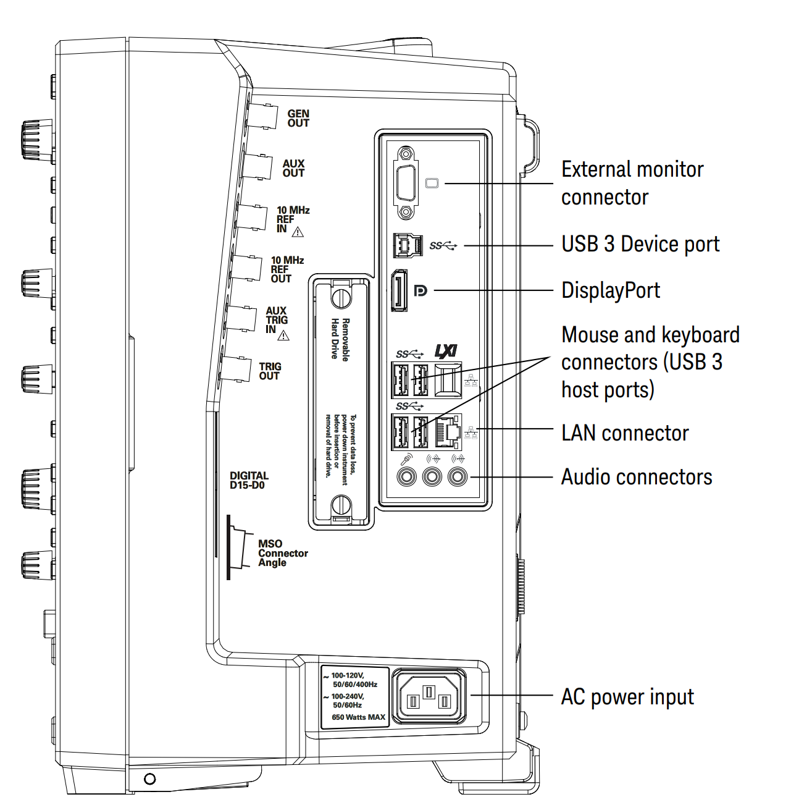
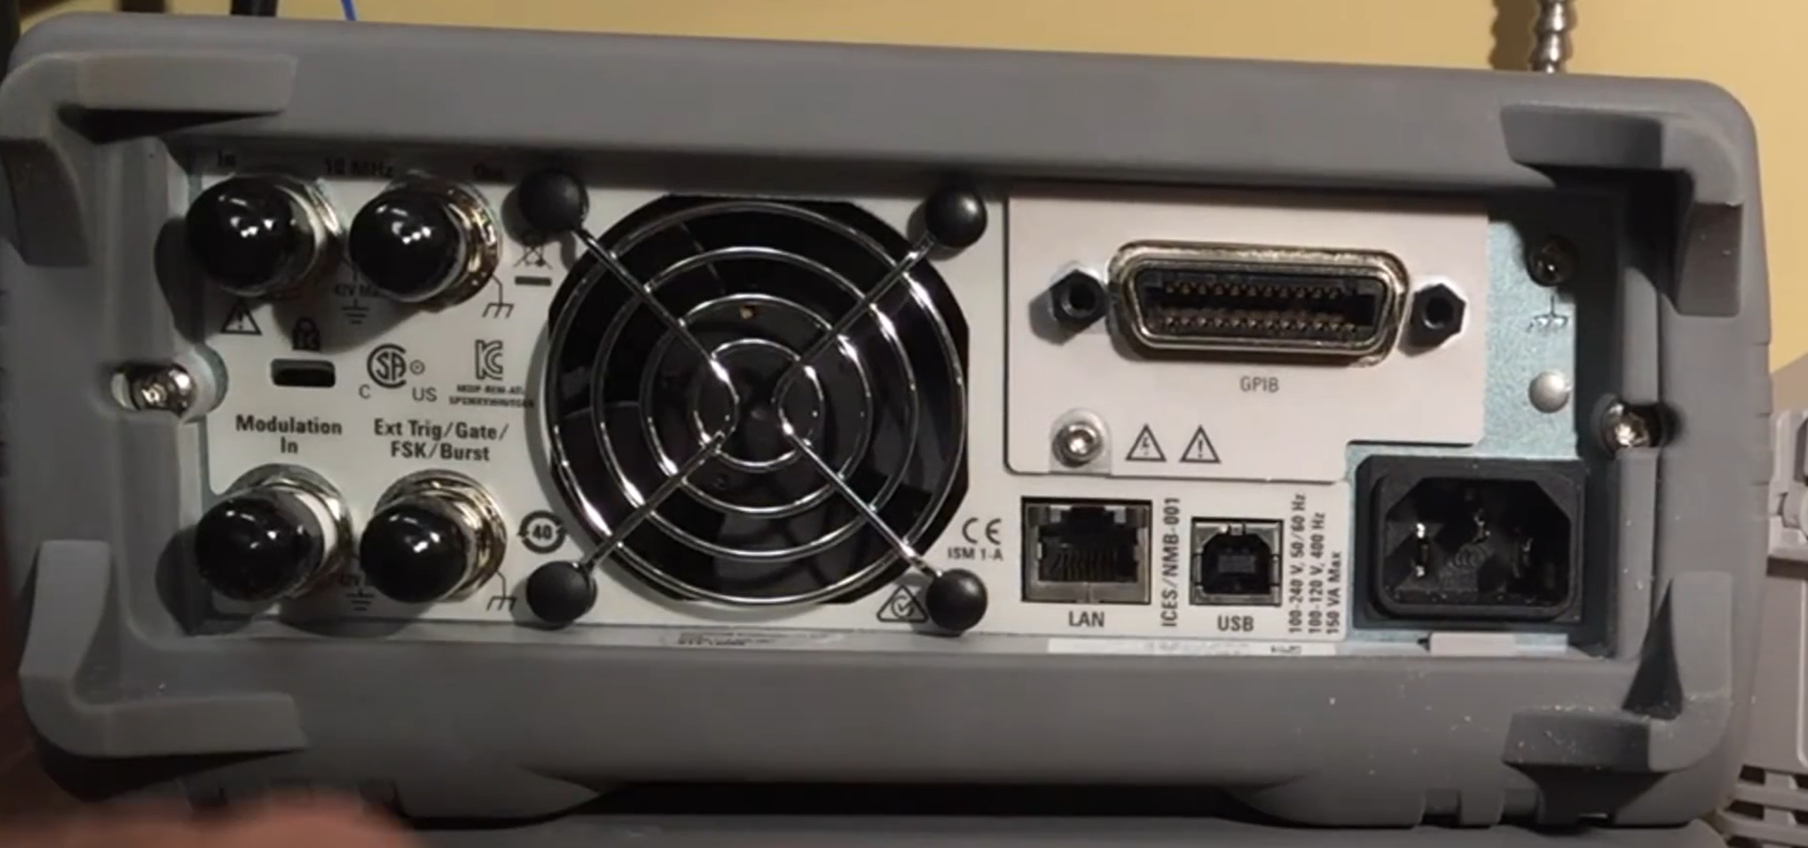
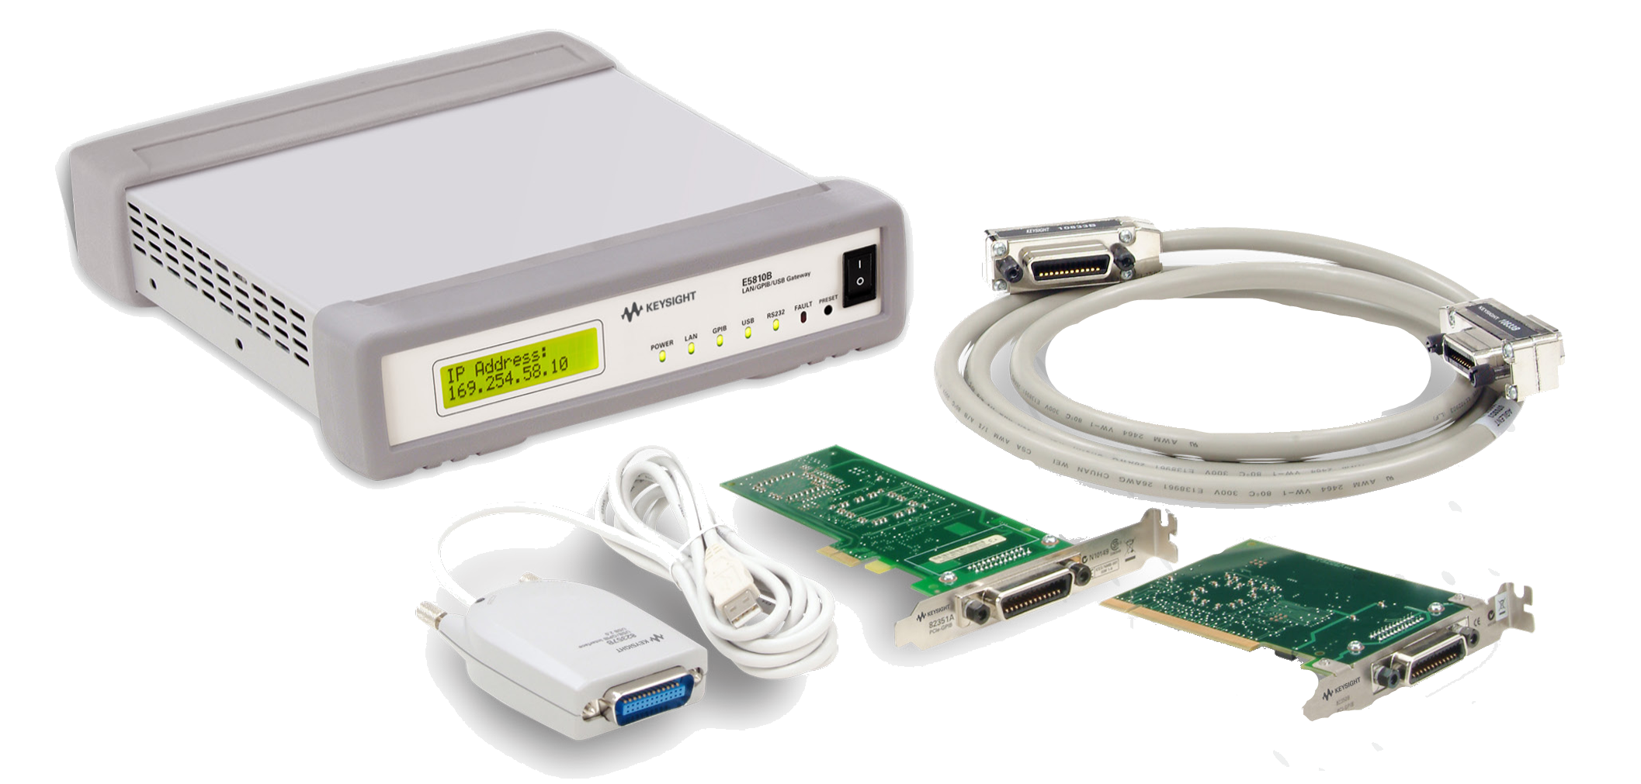



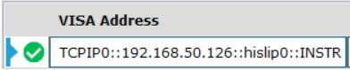
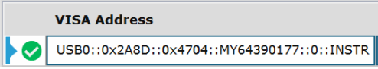
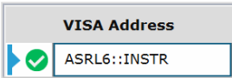
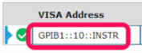
Physical Connection Options
Ethernet is Most common, Check user guide or back panel for options
Pick 1 if an instrument has more than 1 interface and check if you need to turn the interface on in the instrument
GPIB
RS232
USB
USB
LAN

Slide 11

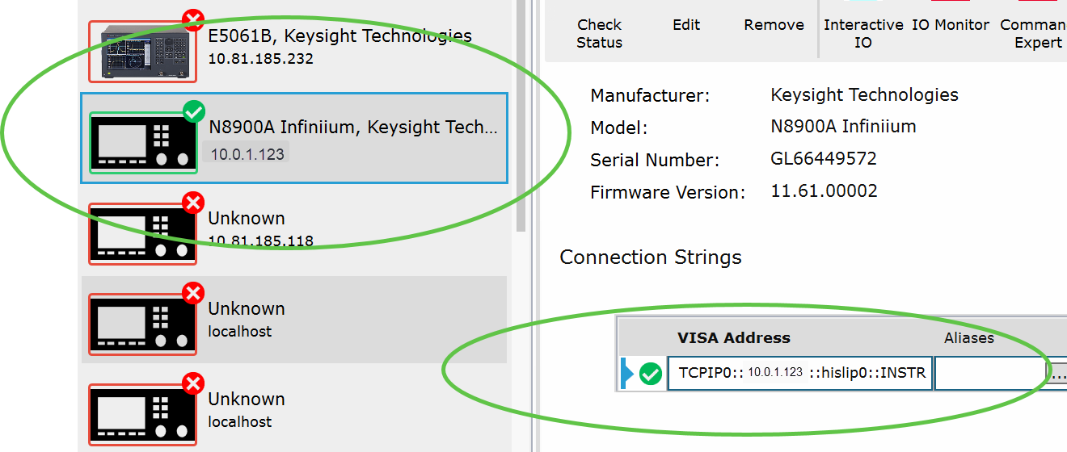
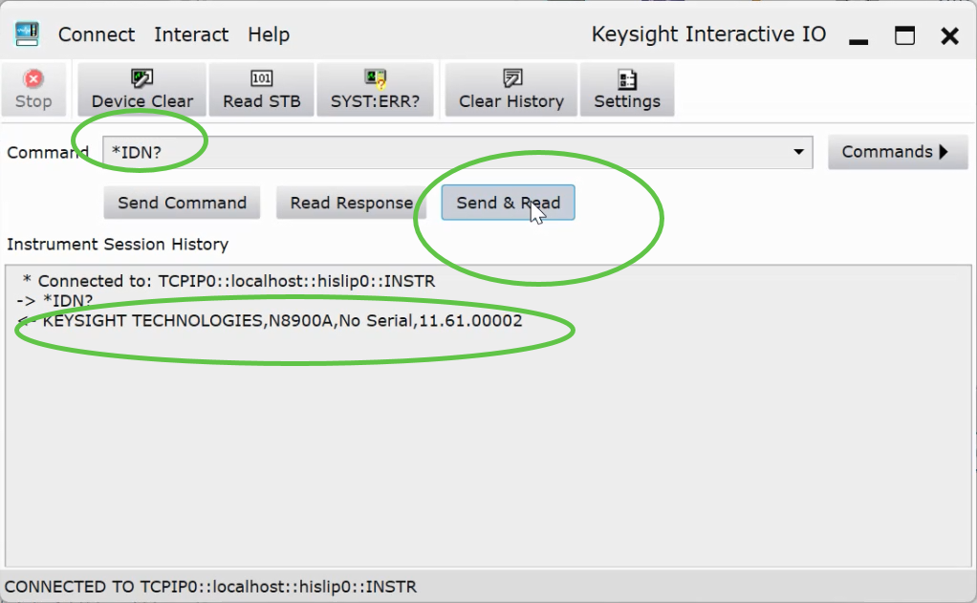

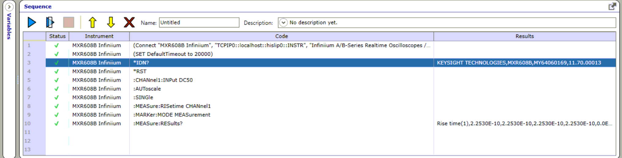

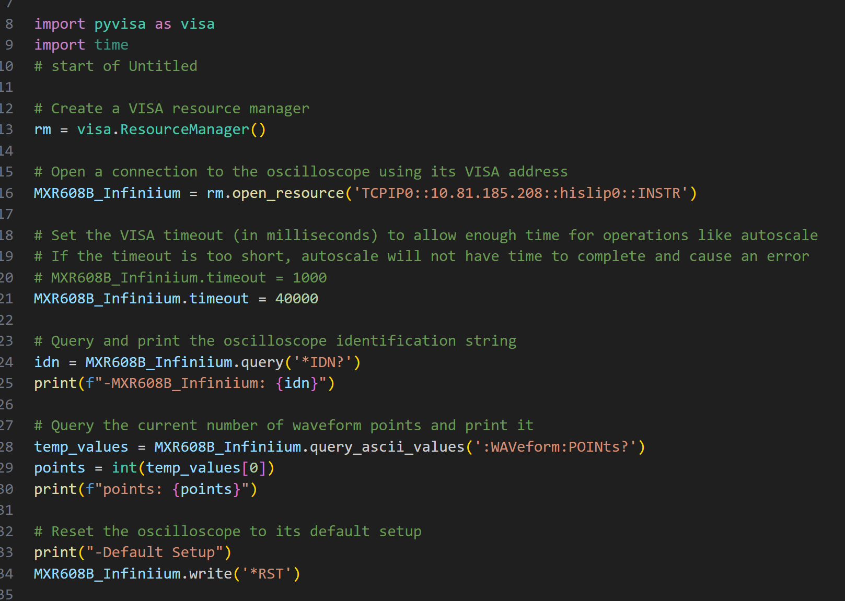
General Workflow
Simple process
Connect with IOLIBS (Connection Expert)
Sanity Check communication *IDN?
Create a sequence of commands (Command Expert)
Export to Python

Slide 12
Automating an MXR Infiniium Scope

Slide 13
Workflow
Walkthrough of a Risetime measurement Automation
Run Manual Steps
Connection,
Interactive IO,
IO Monitor
Commands,
Sequencing,
Profiling,
Exporting
Python Code

Slide 14
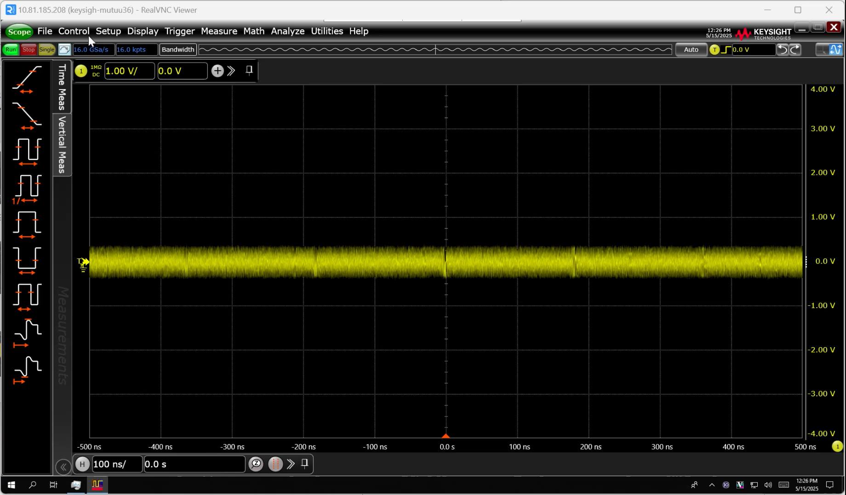
Define your first Program
Video demo
Mxr Scope interface
Manual steps
First, run through the steps manually at the scope
Goal: Make a risetime measurement on MXR scope
Steps:
Default setup
Set input impedance
Autoscale
Add Risetime measurement
Press Single Acquisition
Remember: Automation is a sequence of something you would do manually

Slide 15
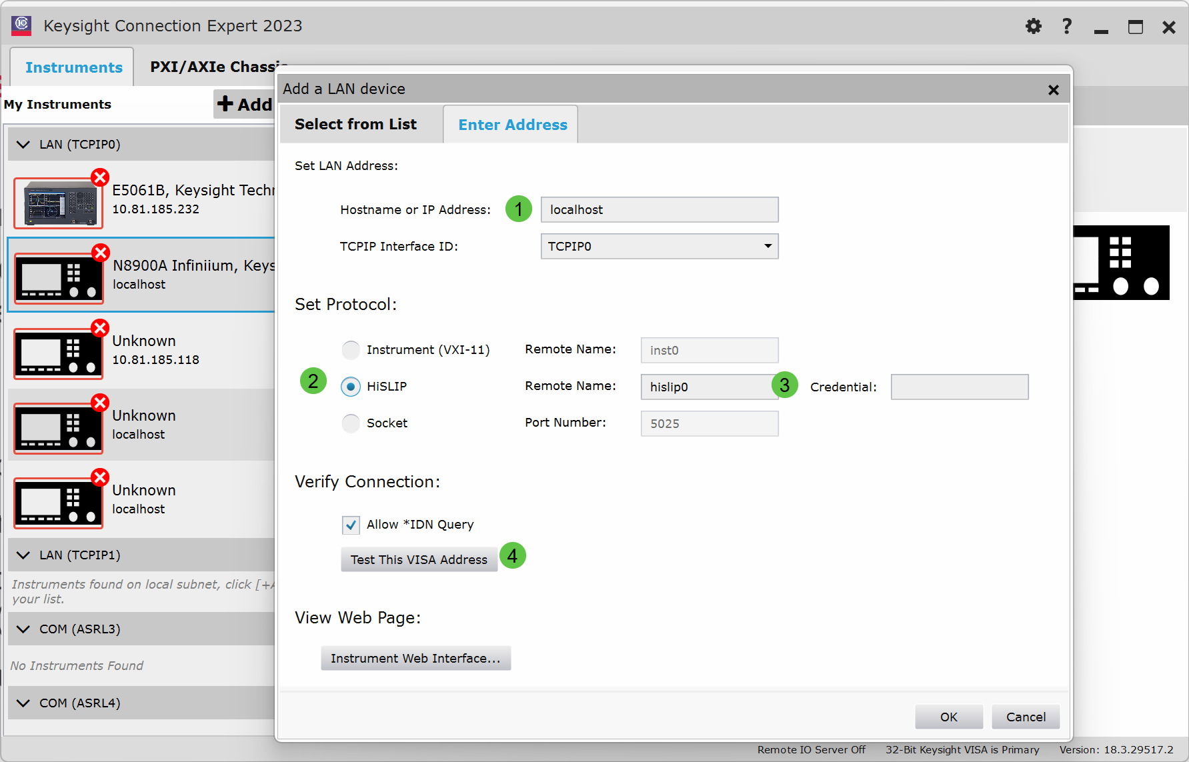
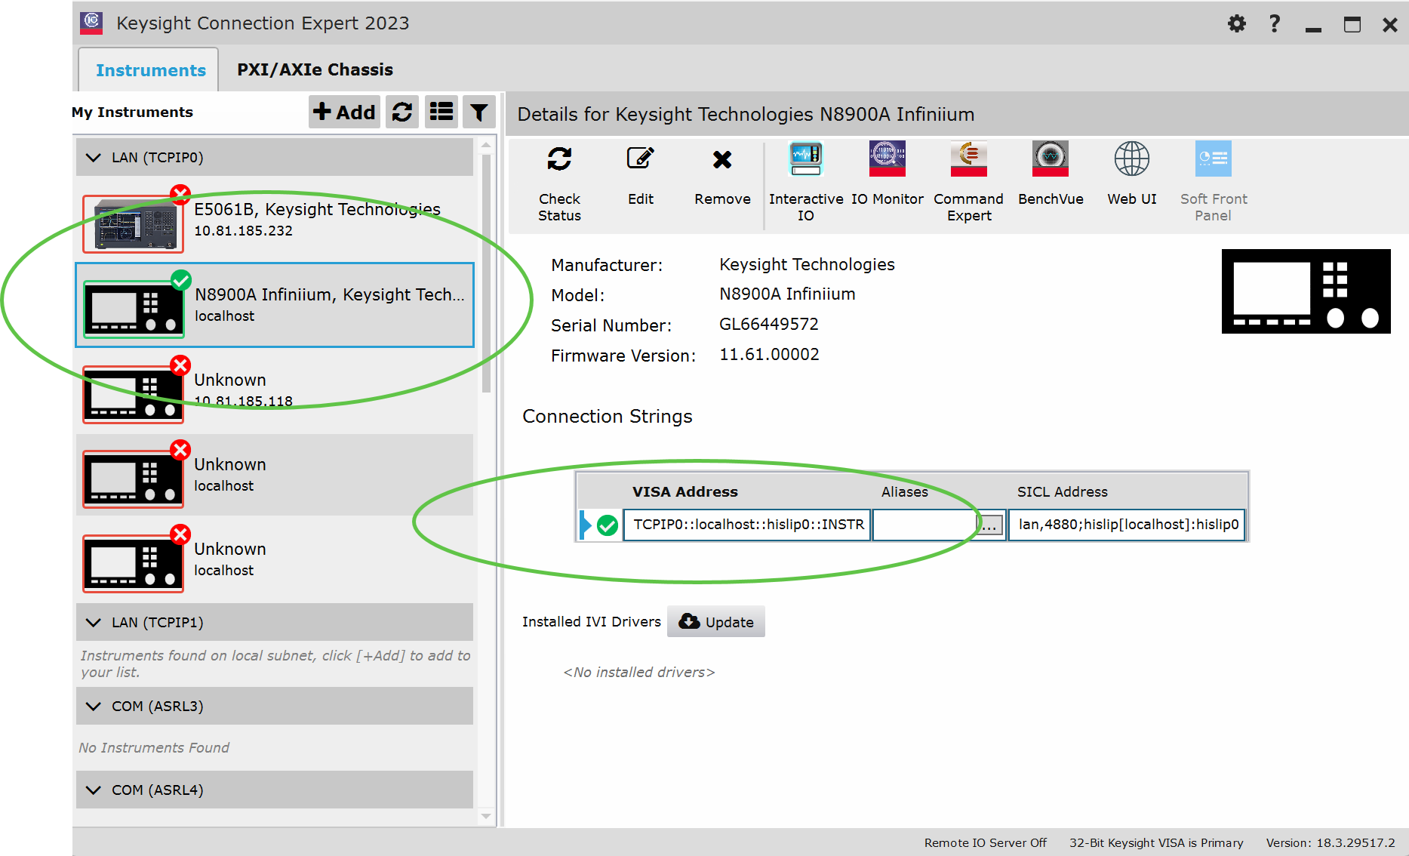
IO Libraries Connection Expert checking connection (localhost)
*IDN? Should always be your first command, sanity check for send and reads and make sure you are controlling the right instrument.

Slide 16
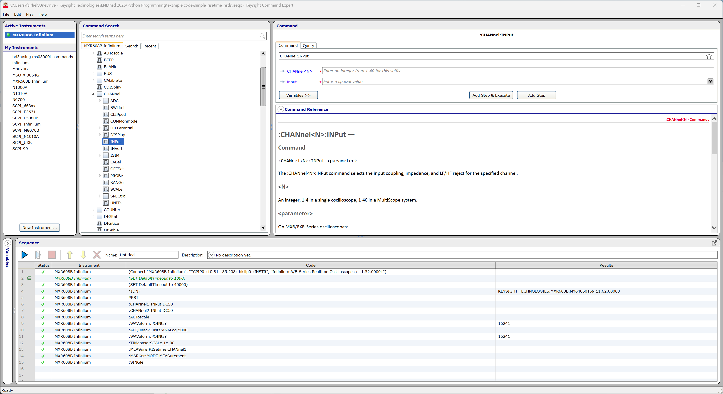
Command Expert
Documentation / command selection
Panel
Command Panel
Instrument Panel
Instrument under control
Commands
Query Results
Sequencer
Panel

Slide 17
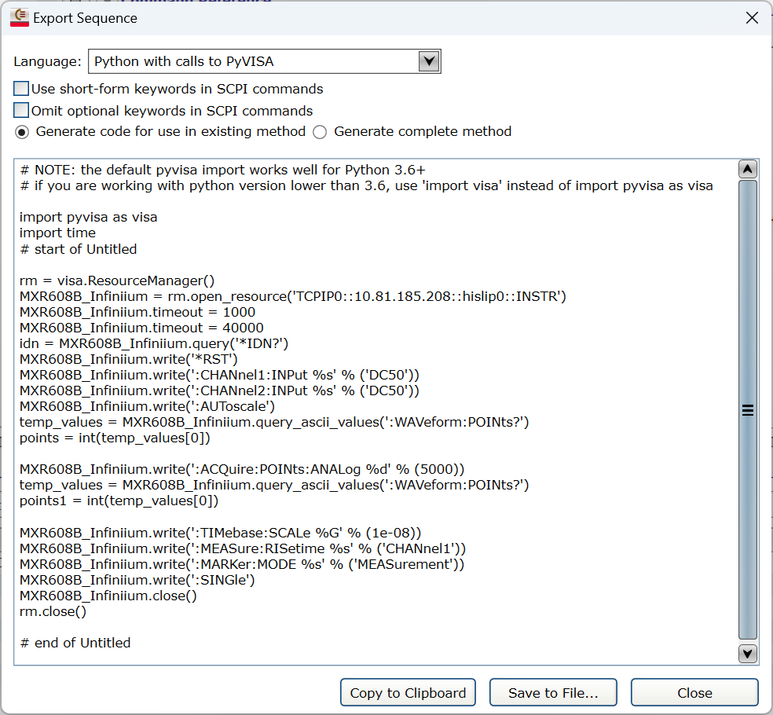
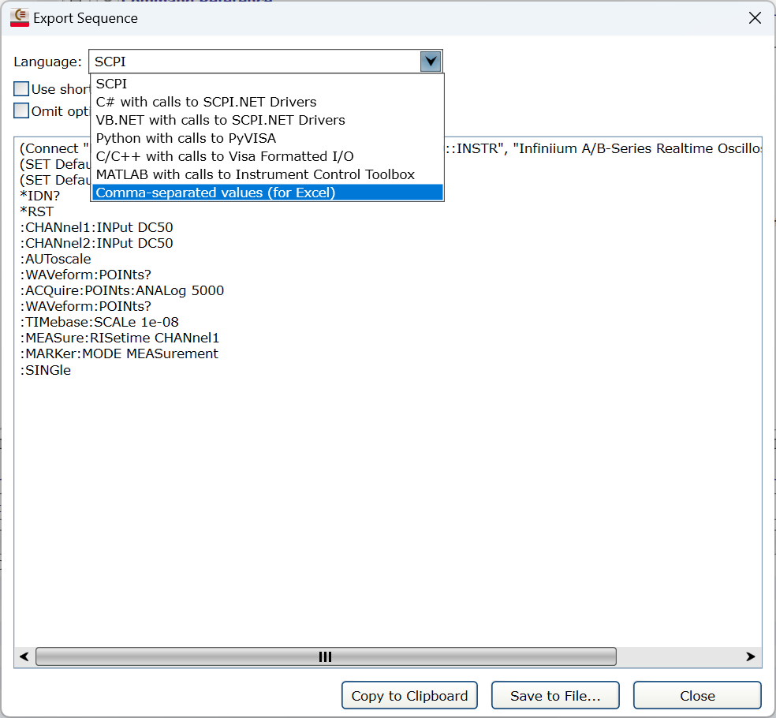
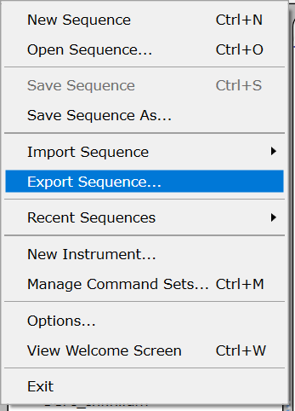
Exporting Code from Command Expert

Slide 18
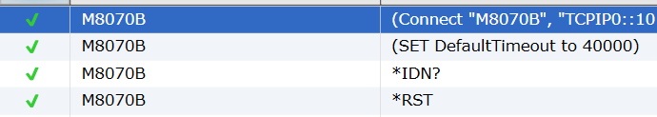
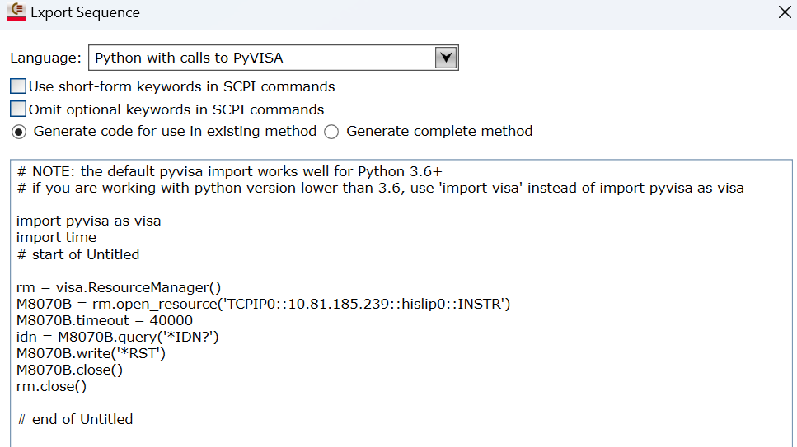
How to Convert SCPI Recorded to Python
Use Command expert to get the Instrument object created then Glue in your code
Create a simple sequence in Command expert that includes
a command
a prompt
Export to Python
Apply the appropriate command or prompt format to the raw SCPI (copy/paste)

Slide 19
Other Coding options: Manually Converting SCPI to Python
:OUTPut:STATe 'M1.DataOut1’,1
Command
M8070B.write(":OUTPut:STATe 'M1.DataOut1’,1")
:OUTPut:STATe? 'M1.DataOut1'
Query
Value=M8070B.query("OUTPut:STATe? 'M1.DataOut1’ “)
print(f“Output state={Value}”)

Slide 20
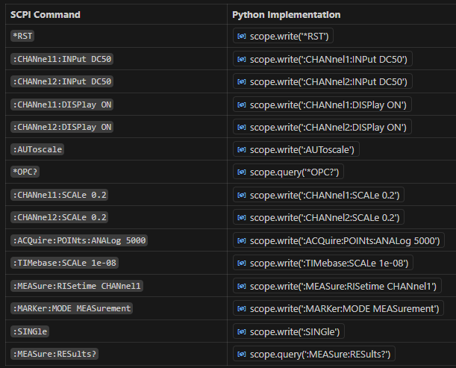
Lets try it out (Walkthrough of MXR Risetime)

Slide 21
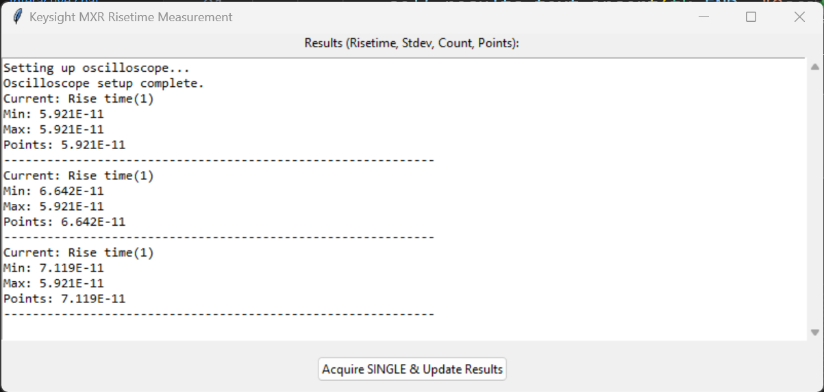
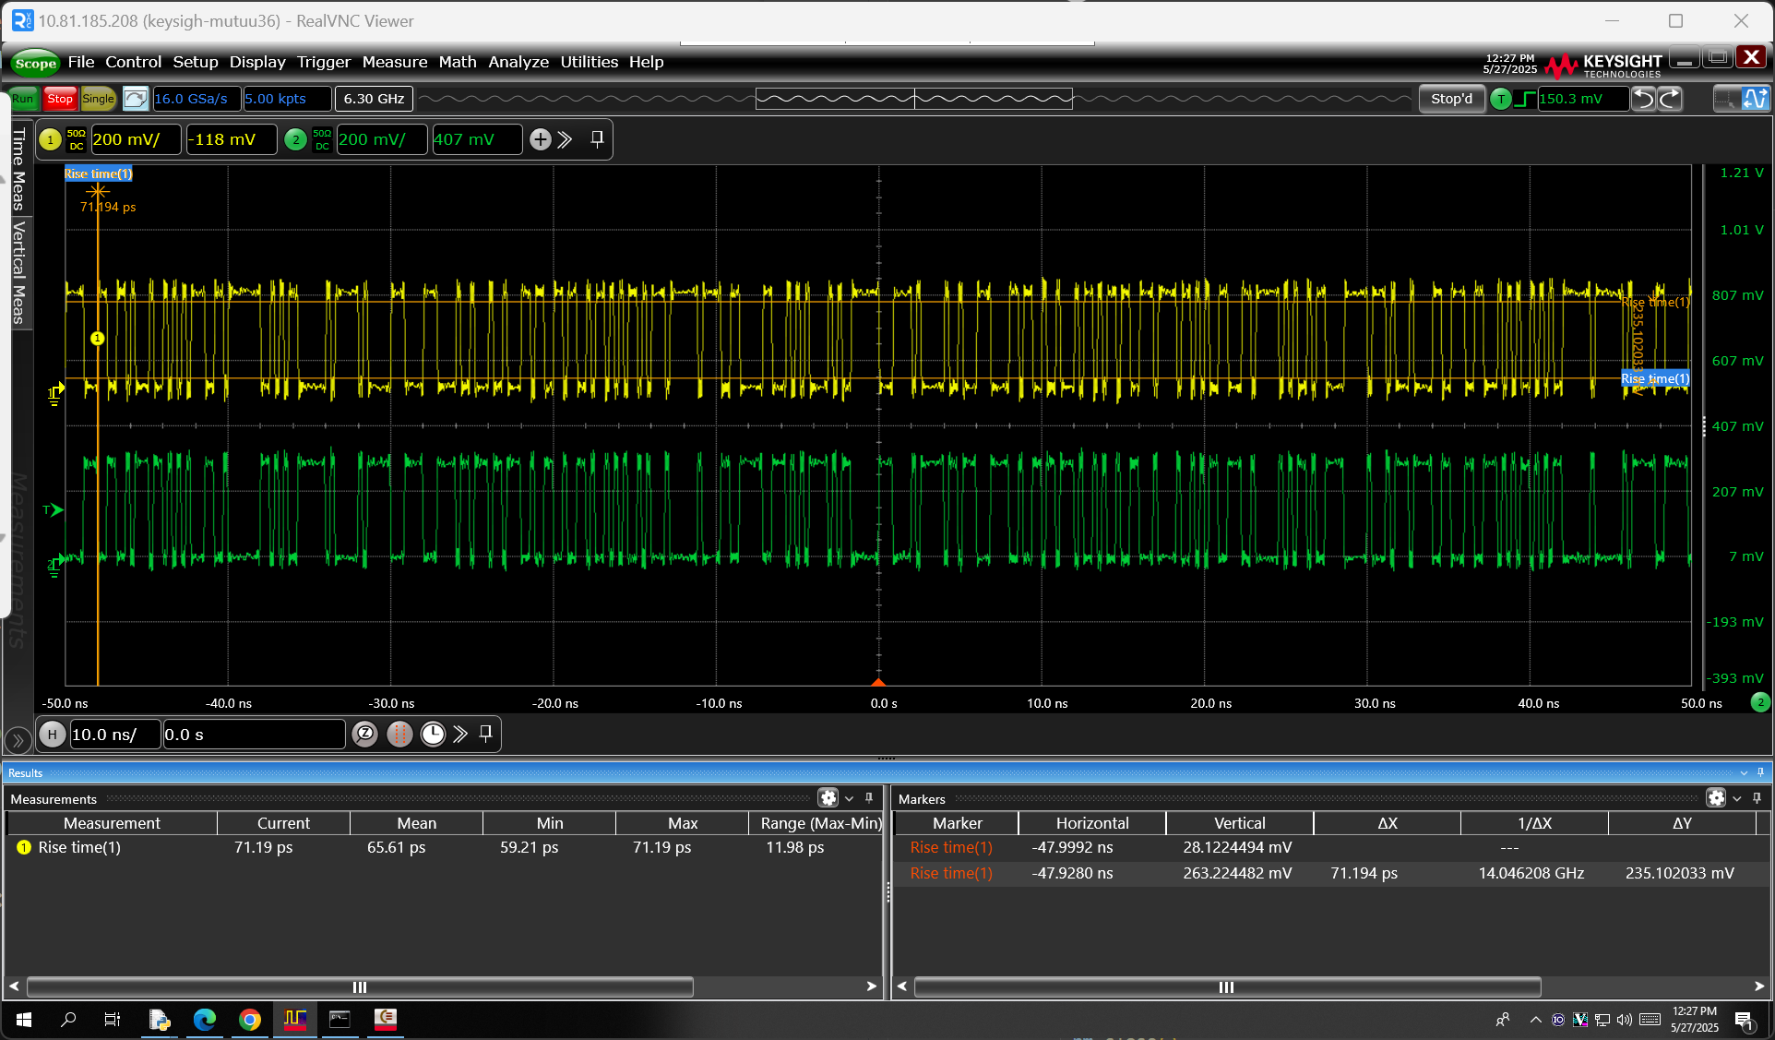
Using AI to assist In Making a Simple GUI
simple_risetime_hsds_gui_version.py
Give it a copy of your code , give it context, and iterate (you may not get the desired results right away)
Prompt: “make this a gui , create a button that every time pressed the SINGLE command is executed and the results update in a text box below after each press. Make sure the text fits in the box “ <<and copy in code>>
Follow up prompt: “make the display of text wider and allow scrolling also dont display the acquire button until setup is complete”
2nd follow up Prompt: “append new results to end instead of overwriting”

Slide 22
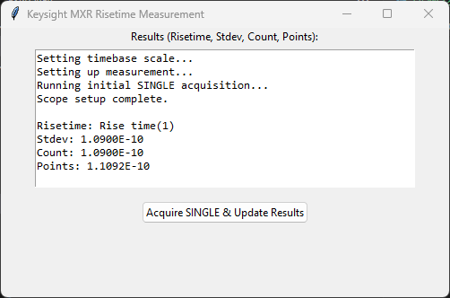
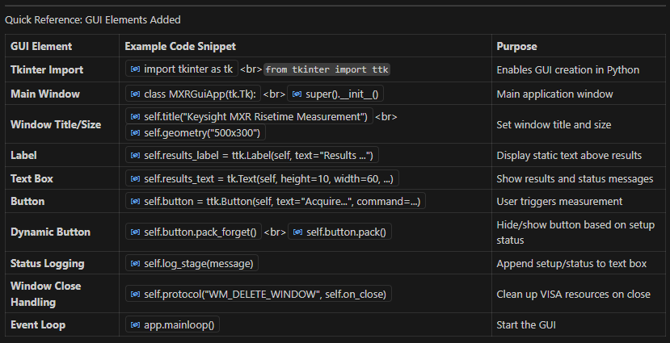
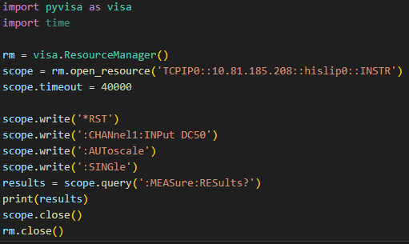
Demo 2 Lets try out the final Code (running the Gui App)

Slide 23
Waveform Data

Slide 24
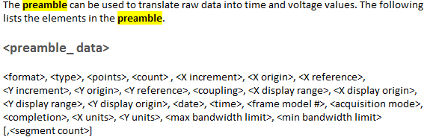
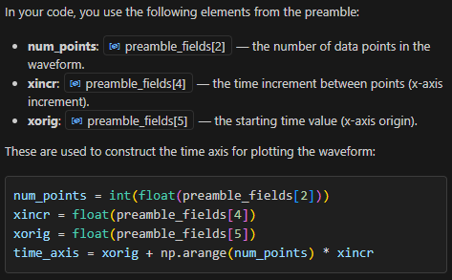
Managing Waveform Data
Using python Matplotlib and extracting and scaling waveform
:Autoscale
*OPC?
:Single
:WAVeform:POINts 1000
:WAVeform:SOURce CHAN1
:WAVeform:FORMat ASCii
:WAVeform:PREamble?
:WAVeform:DATA?

Slide 25
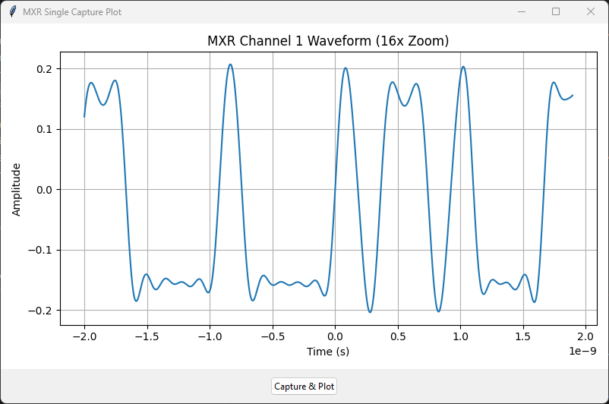
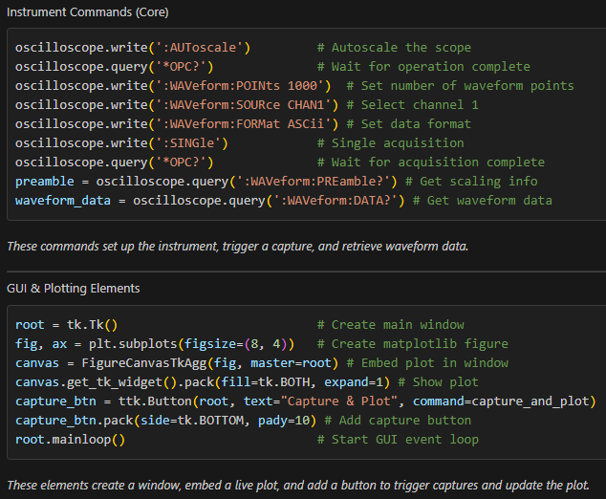
Demo 3 Downloading and Plotting Scope Captured Waveform Data

Slide 26
Writing and testing code without an Instrument

Slide 27
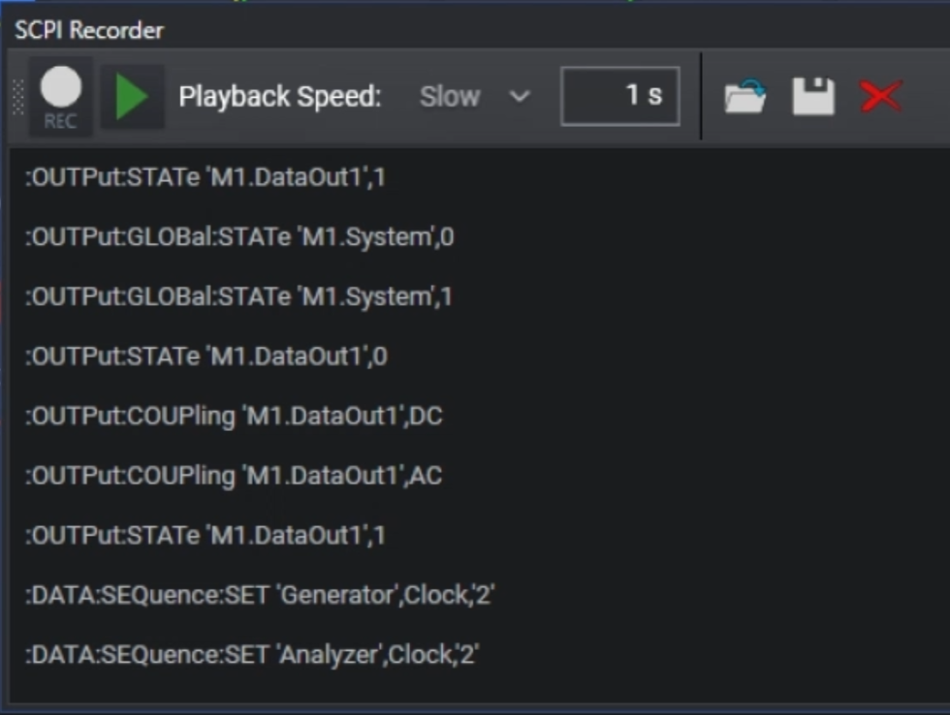
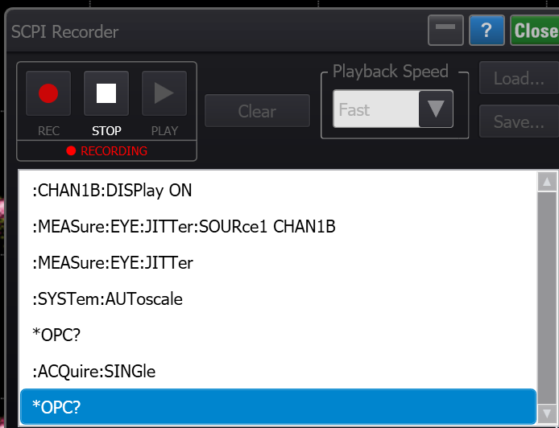
Instruments with SCPI Recorders (takes pain out of looking things up)
Many Keysight Instruments have SCPI recorders, M8070B and FlexDCA shown below

Slide 28
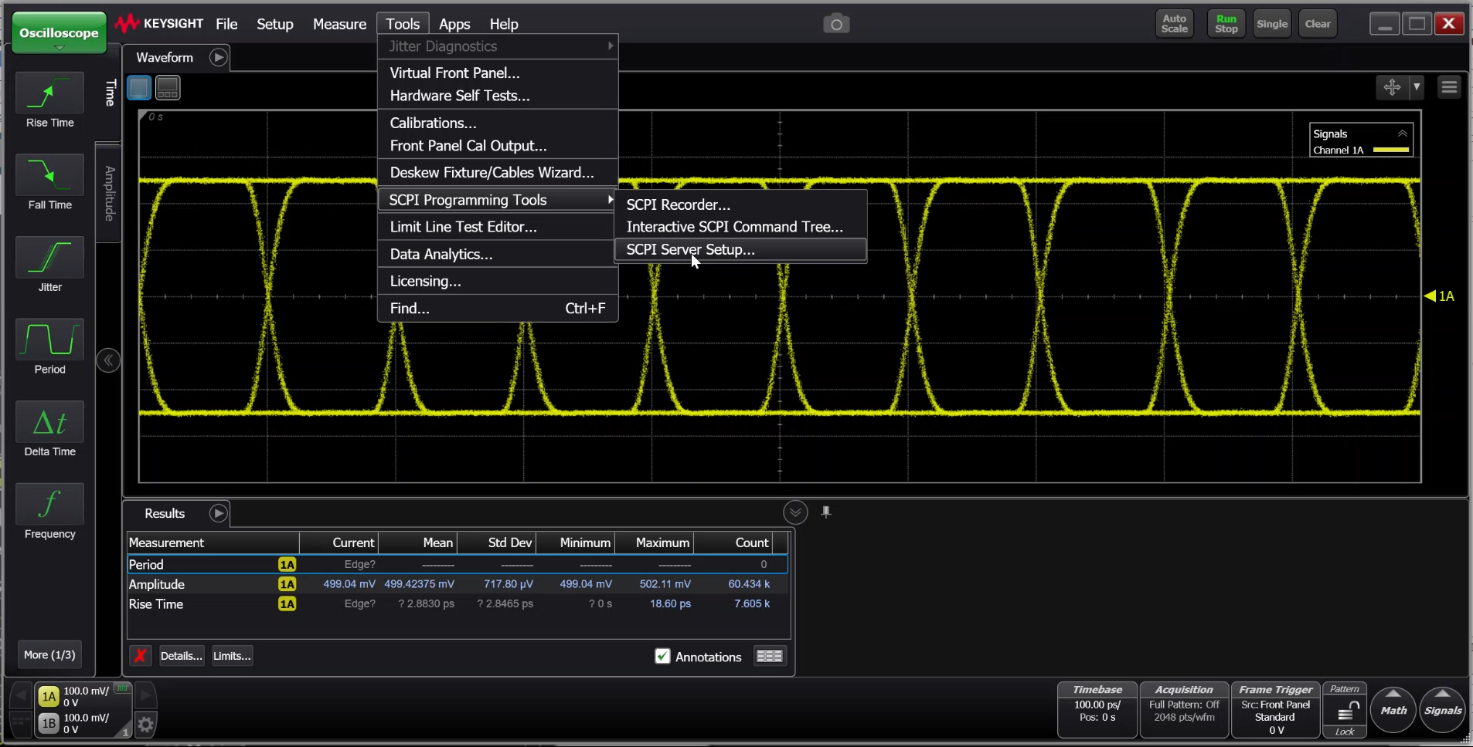

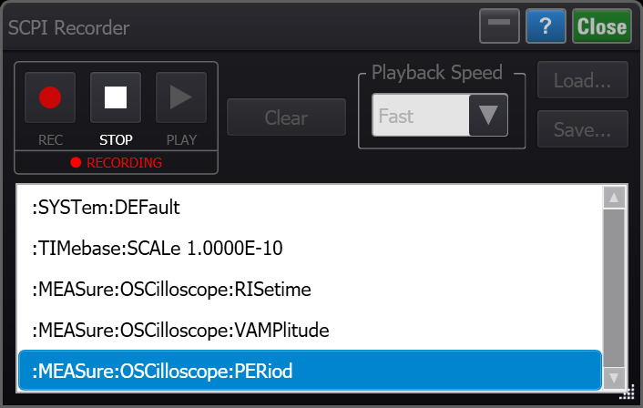

Coding in offline Mode (When no instrument is available)
Using SCPI recorder and AI to quickly Generate code
Run Offline mode,
Walk through Steps
Obtain Address from Flex DCA
Use SCPI Recorder
Prompt AI to convert SCPI to Python
Python Code

Slide 29
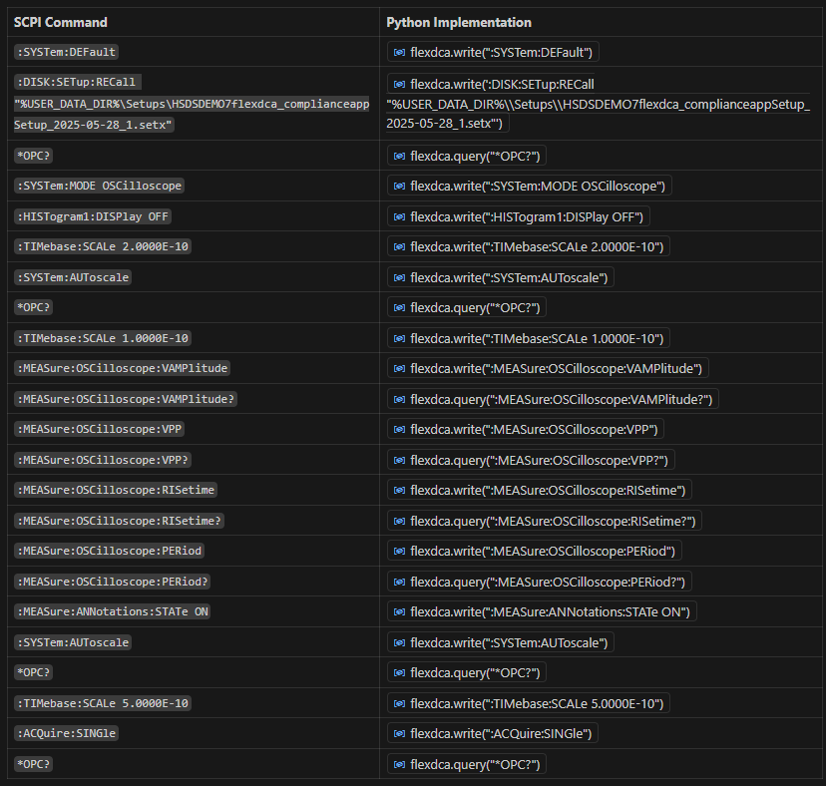
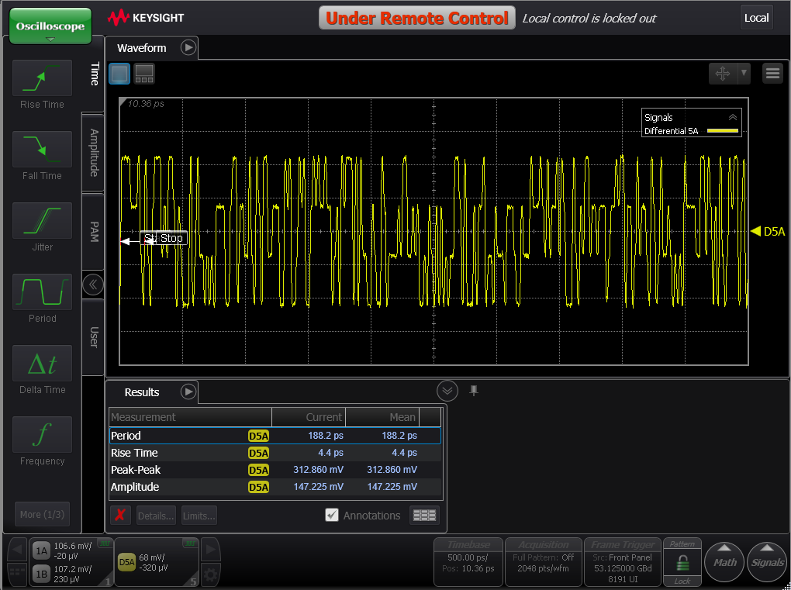
Offline Testing When you have no physical instrument, You can still run code (Lets run generated code on Flex DCA Offline)

Slide 30
Some instruments have specific commands for checking readiness

Slide 31
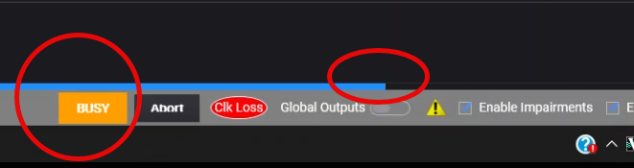
The M8040 and similar Bert series has some unique challenges with Timing
Some operations take a long time to execute, if not handled correctly can be extremely frustrating
*RST (reset or hard reset)
Changing Clock Speeds
Interference sources changing values
It is imperative to have a reliable method to know when the BERT is finished setting up and is ready.
OPC? Operation Complete works well as a blocking statement for Scopes but not here.
The best to way to deal with this is to poll for Dataout ready.
This is an Instrument Specific recommendation
while True:
status = int(instr.query(':STATus:INSTrument:RUN? "M1.DataOut1"').strip())
print(f"Polling DataOut1 ready status: {status}")
if status == 1:
print("Instrument is ready.")
break

Slide 32
Automating 2 instruments at the same time

Slide 33
Adding a second instrument to your automation
Defining our second program:
We will Use M8040 and set 1 frequency in the M8070A Software
Set default timeout to 10 seconds
*IDN? Sanity check and also do this for the M8040A
Report instruments installed options *OPT?
Default Setup *RST
Setup first frequency M8040A
Autoscale
Measure Frequency, Report it
Change clock frequency on M8040A
Autoscale
Measure New Frequency, Report it
Export sequence as Python Code
Execute from Python IDE

Slide 34
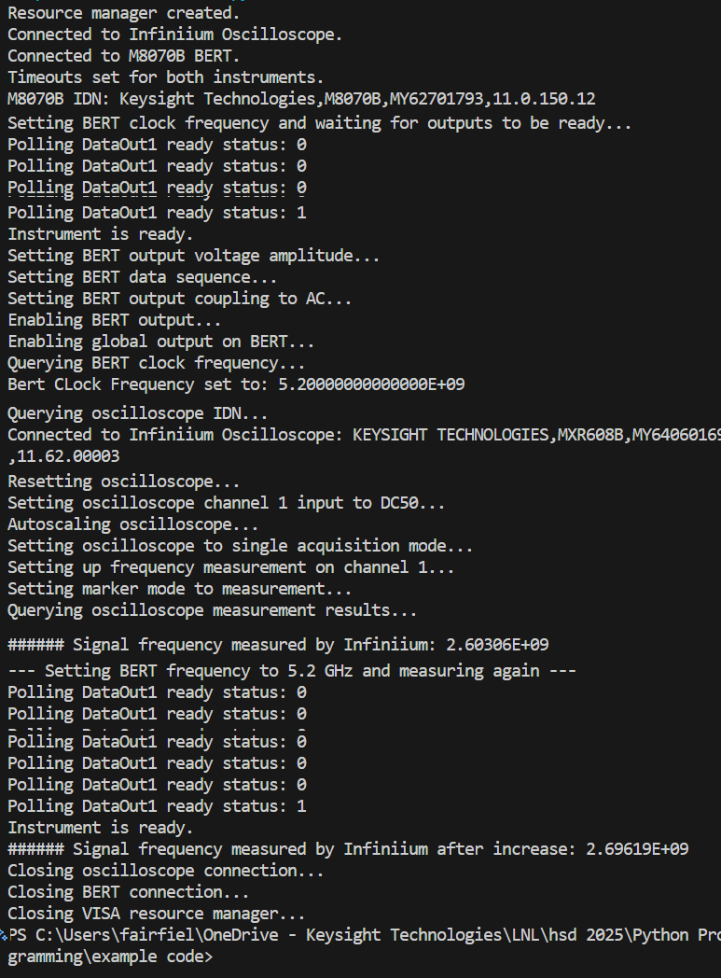
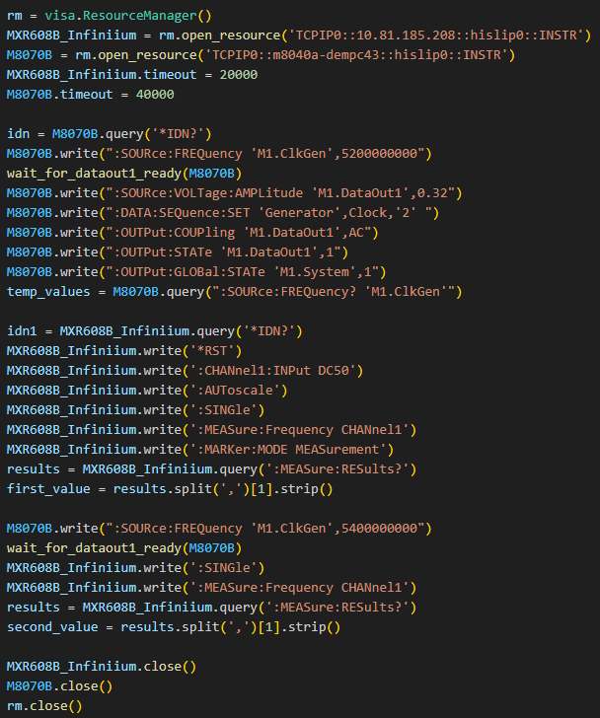
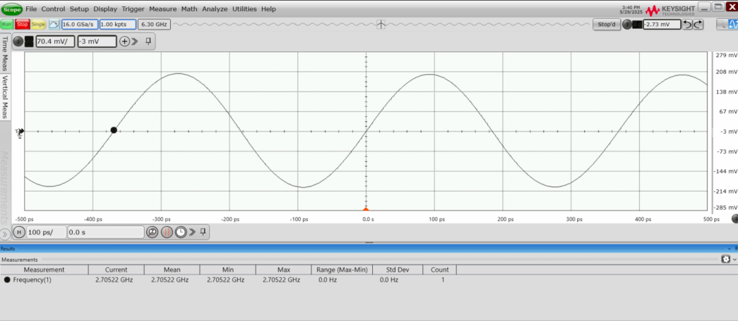
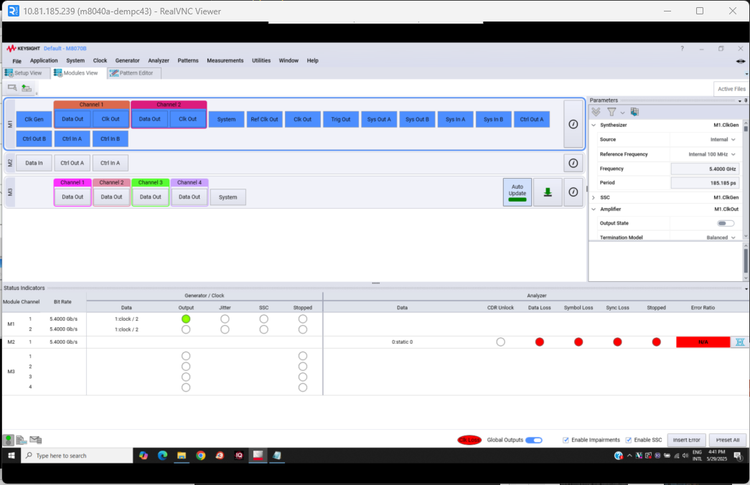
A quick Look: Automating 2 Instruments MXR , M8040A, Note each unique resource name

Slide 35
Best Practices
Always start with *RST from a know condition
Always sanity check with *IDN?
Make sure you understand the sequence of the measurement
Don’t rely on Autoscale functions, instead, set scales manually for repeatability
Make sure your programs live in User space in the OS otherwise security may block execution
Repurposing existing code
If you have an automation setup for one Vendor’s Instrument that is of the same type as your instrument, , you can re-use a lot of the commands.
You may have to make substitutions for Vendor specific ‘Custom” instrument commands.

Slide 36
Be aware that in a busy lab , LAN may slow down with multiple instruments
“But it worked last week”
Some automation Can Move a lot of data and you may get added latency
This becomes more of an issue when you haven’t considered synchronization Strategy between the program and instruments.
A combination of localization and synchronization needs to be considered or you may run into software errors related to delay that world otherwise not show up in an isolated setup
Not all your issues will be exposed in initial coding, may appear months later if you didn’t consider latency issues that are dynamic

Slide 37

Summary: Think Like you are at the Bench!!
Automation = Manual Process, Scripted You're replicating what you'd normally do by hand—just in code.
Plan the Sequence Set up instruments in the right order:
Arm the oscilloscope
Prepare the DMM (if used)
Set voltage/current limits on the power supply
Power on the supply
Synchronize Actions Timing matters—just like at the bench, everything must be ready before powering up.
You may have to wait until an instrument has executed a command (Autoscale may take a few seconds to complete)
Understand Before You Automate Know the manual process well—it’s the foundation for reliable automation.

Slide 38
Summary Where to get Code , commands and Snippets
Command expert
Programmers reference for the product
Example code
Scpi recorders if the instrument supports it
Porting code found on the web.

Slide 39
The current state of AI is powerful, but flawed. We are hitting a "Data Wall" and an "Abstraction Wall." Instead of waiting for a distant superintelligence (AGI), we must use today's AI as an Efficiency Multiplier.
This is Paraphrased from recent Youtube interviews with Geoffrey Hinton,
Ilya Sutskever and Alex Krizhevsy
about limitations where all the data in the world is not producing overwhelming results in business etc, not until we stop using LLMs
AI's Core Limitation | The Problem | Your Essential Role
1. The Statistical Limit | Current models excel at mimicry (predicting the next word) but lack true judgment or the ability to handle completely novel problems | Provide Judgment & Strategy You set the goal, define the 'why,' and apply human principles (taste, ethics) to the generated output.
2. The Inconsistency Flaw | AI can be highly productive but is prone to unpredictable inconsistency (e.g., getting stuck in bug loops) and cannot reliably bridge the gap to the physical world | Be the Quality Controller You must verify, fact-check, and apply the final, critical accuracy review to ensure output is reliable and feasible.
3. The Efficiency Gap | Lacking the human 'value function' (emotion/internal compass), AI must inefficiently calculate every option, leading to decision paralysis without human input | Define Value & Priority You must provide the emotional context and priority to guide the pure logic toward the most useful and efficient path.
Takeaway: AI handles the statistical drudgery. You provide the Judgment, Quality, and Purpose.

Slide 40
Vibe coding VS Planned Coding
Best workflow: Vibe to explore → Plan to stabilize / Refactor for reuse
Aspect | Vibe Coding | Planned Coding / Prompt Engineering
Goal | Explore & get something working fast | Build correct, repeatable, scalable code
Speed to first result | ⭐⭐⭐⭐⭐ Very fast | ⭐⭐ Slower startup
Structure | Emerges organically (or not at all) | Defined upfront (functions, flow, contracts)
Memory / state assumptions | Often implicit | Explicit and documented
LLM interaction | Short, reactive prompts | Precise, constrained prompts
Scalability | Breaks down as code grows | Scales to large scripts/projects
Maintainability | Harder to debug & extend | Easier to read, test, and reuse
Best use cases | Demos, notebooks, learning, exploration | Production scripts, libraries, teaching
Risk | Hidden bugs, fragile logic | Over-design, slower iteration

Slide 41






Using AI to Help you :My Prompt Engineering Workflow for better success
Watching and Learning on youtube from different points of view I saw a common workflow being used
A Formal Workflow for Technical Work
Define the Objective — measurable, simple, testable
Provide Context — documents/ user guides, code samples, architecture
Set Boundaries/Constraints — no invention from the bot, tell it to ask questions if unclear
Define Success Rubric — provide the context of what you consider success for the goal and have the AI evaluate itself Ask for Test Vectors to be run
Iterate to Completion — refine until rubric passes 90%
Key insight: Create meta prompts, chat with AI to create better prompts, have it ask you questions if some parameters are unclear.
Sandbox the Environment — isolated run-space with logs, this provides a safe environment space for the AI to automatically run commands and interate the results (it can read the terminal responses)

Slide 42
Meta prompts: Using prompts to create better prompts
Example Prompt phrases to include which really have an impact
““You are a senior software engineer and data scientist. Write clean, production-quality Python using industry best practices (readable structure, clear naming, error handling, and logging). Prefer simple, maintainable solutions over clever ones.””
“You are a meticulous programmer-data scientist. For every function you write, also generate unit tests and test vectors, including edge cases and failure scenarios. Explicitly show the expected inputs and outputs.”
“You Are Alan Copeland..’nuff said

Slide 43




Applied Workflow: AI-Generated Python Control of M8196A
Customer wanted Python parameter-based signal generation, for the M8196A
Define Objective
simple Python interface for freq, duty cycle, sweeps, and multi-arb control, the key is memory calculation and fitting pattern memory boundaries exactly as to not cause spectral issues …
Customer challenge
Needed a simple Python interface for freq, duty cycle, sweeps, and multi-arb control.
Provide Context
-M8195 Programmers reference
-M8195 Users manual
-Iqtools m files
-Example python code
Set Contsraints
Create a VENV, and use a sandbox
allow autonomous actions in this area only, min max frequency generation, min max duty cycle and steps
Define Success with a grade
check for crash, recovery app failures automatically then final quality: human pass/fail checks when prompted by AI
Write test vectors for all channels, sweep multiple duty cycle values, figure out load time issues, various instrument starting states (including a parallel program changing values),
Define tests and Iterate until grade is met

Slide 44


Segmented memory mode Advantages
Single shot capture least optimized but does capture “everything” for that period
rearm
rearm
R
R
R

Slide 45


Simple shot pulse capture and waveform data transfer python demo
Start with Command Expert Sequence, Its simple and allows realtime checking then export

Slide 46

Two transfer modes: “one-at-a-time” vs “all-at-once”
Mode A: One segment at a time (recommended)
Loop: set INDex → :WAVeform:DATA? → :WAVeform:SEGMented:TTAG?
Pros: memory-safe for huge segment counts, easy to stream/process
Cons: more round trips
Mode B: Bulk transfer (all segments concatenated)
Enable :WAVeform:SEGMented:ALL ON then :WAVeform:DATA?
Data comes back as [seg1][seg2]...[segN] with fixed bytes per segment
Pros: fewer transactions, fast for small N
Cons: can be massive; must compute segment boundaries using points & bytes/point
Best practice
Always set waveform source/format explicitly :WAVeform:SOURce, :WAVeform:FORMat, :WAVeform:BYTeorder)
Always disable ALL mode afterward :WAVeform:SEGMented:ALL OFF)

Slide 47


Segment Viewer

Slide 48



Making the app User Friendly Using AI

Slide 49
Resources used
Code examples:
https://github.com/fairdogJR/Segmented-memory-Automation-with-python-infiniium-scopes-
Command Expert
https://www.keysight.com/us/en/lib/software-detail/computer-software/command-expert-downloads-2151326.html
Introduction to Python Automation (circa 2016 Python 2.7)
https://www.youtube.com/playlist?list=PLMFn2UaPBVfWVjCbQh_DsJknlwpVkiIhh

